Slide 1
Using Conversion Functions and Conditional Expressions
Copyright © 2009, Oracle. All rights reserved.

Slide 2
Objectives
After completing this lesson, you should be able to do the following:
Describe the various types of conversion functions that are available in SQL
Use the TO_CHAR, TO_NUMBER, and TO_DATE conversion functions
Apply conditional expressions in a SELECT statement
4 - 2

Slide 3
Lesson Agenda
Implicit and explicit data type conversion
TO_CHAR, TO_DATE, TO_NUMBER functions
Nesting functions
General functions:
NVL
NVL2
NULLIF
COALESCE
Conditional expressions:
CASE
DECODE
4 - 3

Slide 4
Conversion Functions
Data type conversion
Implicit data type
Explicit data type conversion
conversion
4 - 4

Slide 5
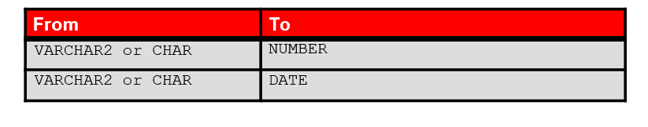
Implicit Data Type Conversion
In expressions, the Oracle server can automatically convert the following:
4 - 5

Slide 6
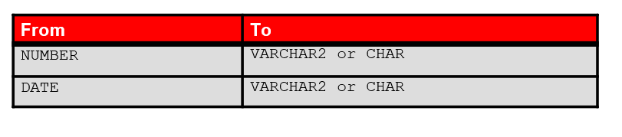
Implicit Data Type Conversion
For expression evaluation, the Oracle server can automatically convert the following:
4 - 6

Slide 7
Explicit Data Type Conversion
TO_NUMBER
TO_DATE
NUMBER
CHARACTER
DATE
TO_CHAR
TO_CHAR
4 - 7

Slide 8
Explicit Data Type Conversion
TO_NUMBER
TO_DATE
NUMBER
CHARACTER
DATE
TO_CHAR
TO_CHAR
4 - 8

Slide 9
Lesson Agenda
Implicit and explicit data type conversion
TO_CHAR, TO_DATE, TO_NUMBER functions
Nesting functions
General functions:
NVL
NVL2
NULLIF
COALESCE
Conditional expressions:
CASE
DECODE

Slide 10
Using the TO_CHAR Function with Dates
TO_CHAR(date, 'format_model')
The format model:
Must be enclosed with single quotation marks
Is case-sensitive
Can include any valid date format element
Has an fm element to remove padded blanks or suppress leading zeros
Is separated from the date value by a comma

Slide 11
Elements of the Date Format Model
Element | Result
YYYY | Full year in numbers
YEAR | Year spelled out (in English)
MM | Two-digit value for the month
MONTH | Full name of the month
MON | Three-letter abbreviation of the month
DY | Three-letter abbreviation of the day of the week
DAY | Full name of the day of the week
DD | Numeric day of the month

Slide 12
Elements of the Date Format Model
Time elements format the time portion of the date:
HH24:MI:SS AM
15:45:32 PM
Add character strings by enclosing them with double quotation marks:
Number suffixes spell out numbers:
DD | "of" | MONTH | 12 | of | OCTOBER
ddspth
fourteenth
4 - 14

Slide 13
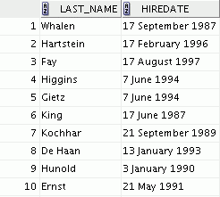
Using the TO_CHAR Function with Dates
SELECT last_name,
TO_CHAR(hire_date, 'fmDD Month YYYY') AS HIREDATE
FROM employees;
…

Slide 14
Using the TO_CHAR Function with Numbers
TO_CHAR(number, 'format_model')
These are some of the format elements that you can use with the TO_CHAR function to display a number value as a character:
Element | Result
9 | Represents a number
0 | Forces a zero to be displayed
$ | Places a floating dollar sign
L | Uses the floating local currency symbol
. | Prints a decimal point
, | Prints a comma as a thousands indicator

Slide 15

Using the TO_CHAR Function with Numbers
SELECT TO_CHAR(salary, '$99,999.00') SALARY
FROM employees
WHERE last_name = 'Ernst';

Slide 16
Using the TO_NUMBER and TO_DATE Functions
Convert a character string to a number format using the
TO_NUMBER function:
TO_NUMBER(char[, 'format_model'])
Convert a character string to a date format using the
TO_DATE function:
TO_DATE(char[, 'format_model'])
These functions have an fx modifier. This modifier specifies the exact match for the character argument and date format model of a TO_DATE function.

Slide 17

Using the TO_CHAR and TO_DATE Function with the RR Date Format
To find employees hired before 1990, use the RR date format, which produces the same results whether the command is run in 1999 or now:
SELECT last_name, TO_CHAR(hire_date, 'DD-Mon-YYYY') FROM employees
WHERE hire_date < TO_DATE('01-Jan-90','DD-Mon-RR');

Slide 18
Lesson Agenda
Implicit and explicit data type conversion
TO_CHAR, TO_DATE, TO_NUMBER functions
Nesting functions
General functions:
NVL
NVL2
NULLIF
COALESCE
Conditional expressions:
CASE
DECODE

Slide 19
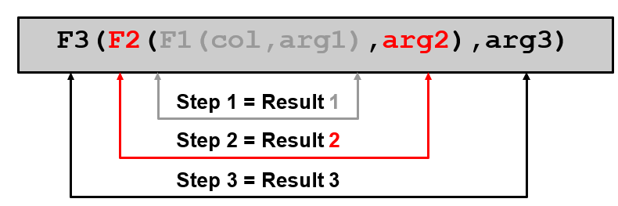
Nesting Functions
Single-row functions can be nested to any level.
Nested functions are evaluated from the deepest level to the least deep level.

Slide 20

Nesting Functions: Example 1
SELECT last_name,
UPPER(CONCAT(SUBSTR (LAST_NAME, 1, 8), '_US'))
FROM employees
WHERE department_id = 60;

Slide 21
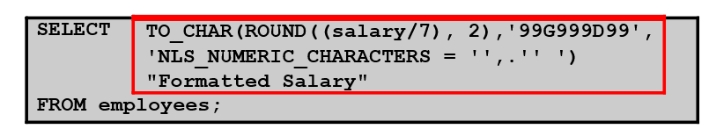
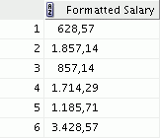
Nesting Functions: Example 2
…

Slide 22
Lesson Agenda
Implicit and explicit data type conversion
TO_CHAR, TO_DATE, TO_NUMBER functions
Nesting functions
General functions:
NVL
NVL2
NULLIF
COALESCE
Conditional expressions:
CASE
DECODE

Slide 23
General Functions
The following functions work with any data type and pertain to using nulls:
NVL (expr1, expr2)
NVL2 (expr1, expr2, expr3)
NULLIF (expr1, expr2)
COALESCE (expr1, expr2, ..., exprn)

Slide 24
NVL Function
Converts a null value to an actual value:
Data types that can be used are date, character, and number.
Data types must match:
NVL(commission_pct,0)
NVL(hire_date,'01-JAN-97')
NVL(job_id,'No Job Yet')

Slide 25
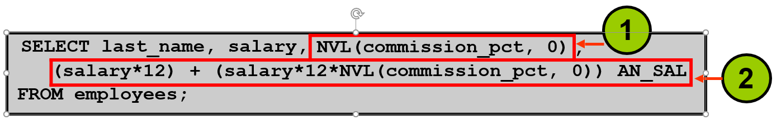
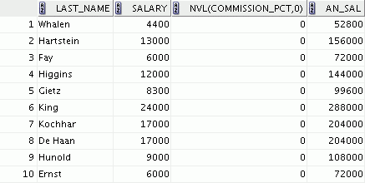
Using the NVL Function
…
1
2

Slide 26
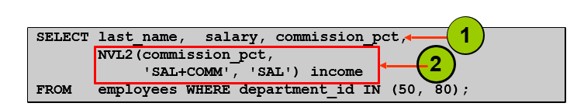
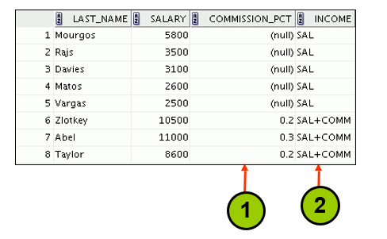
Using the NVL2 Function

Slide 27
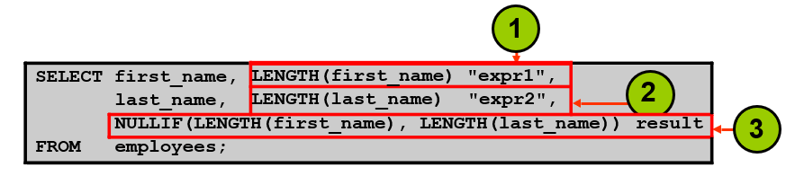
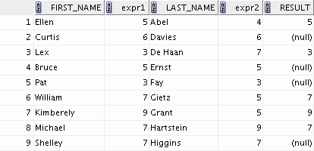
Using the NULLIF Function
…
1
2
3

Slide 28
Using the COALESCE Function
The advantage of the COALESCE function over the NVL function is that the COALESCE function can take multiple alternate values.
If the first expression is not null, the COALESCE function returns that expression; otherwise, it does a COALESCE of the remaining expressions.

Slide 29
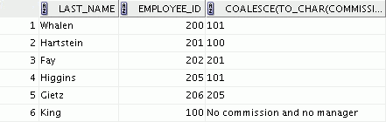

Using the COALESCE Function
SELECT last_name, employee_id, COALESCE(TO_CHAR(commission_pct),TO_CHAR(manager_id),
'No commission and no manager') FROM employees;
…

Slide 30
Lesson Agenda
Implicit and explicit data type conversion
TO_CHAR, TO_DATE, TO_NUMBER functions
Nesting functions
General functions:
NVL
NVL2
NULLIF
COALESCE
Conditional expressions:
CASE
DECODE

Slide 31
Conditional Expressions
Provide the use of the IF-THEN-ELSE logic within a SQL statement.
Use two methods:
CASE expression
DECODE function

Slide 32
CASE Expression
Facilitates conditional inquiries by doing the work of an
IF-THEN-ELSE statement:
CASE expr WHEN | comparison_expr1 | THEN | return_expr1
[WHEN | comparison_expr2 | THEN | return_expr2
WHEN | comparison_exprn | THEN | return_exprn
ELSE | else_expr]
END

Slide 33
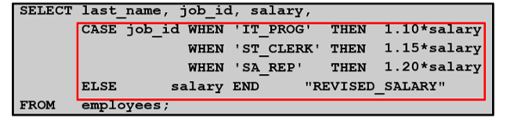
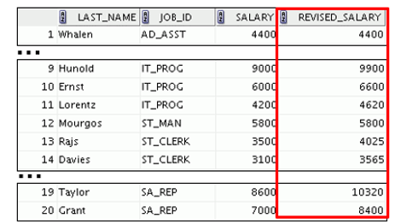
Using the CASE Expression
Facilitates conditional inquiries by doing the work of an
IF-THEN-ELSE statement:

Slide 34
DECODE Function
Facilitates conditional inquiries by doing the work of a CASE
expression or an IF-THEN-ELSE statement:
DECODE(col|expression, search1, result1
[, search2, result2,...,] [, default])

Slide 35
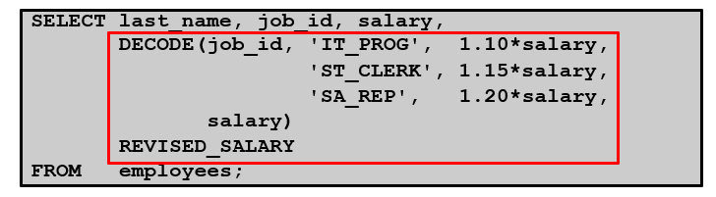
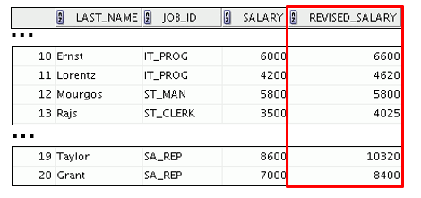
Using the DECODE Function

Slide 36
Using the DECODE Function
Display the applicable tax rate for each employee in department 80:
SELECT last_name, salary,
DECODE (TRUNC(salary/2000, 0),
0, 0.00,
1, 0.09,
2, 0.20,
3, 0.30,
4, 0.40,
5, 0.42,
6, 0.44,
0.45) TAX_RATE
FROM employees
WHERE department_id = 80;

Slide 37
Quiz
The TO_NUMBER function converts either character strings or date values to a number in the format specified by the optional format model.
True
False

Slide 38
Summary
In this lesson, you should have learned how to:
Alter date formats for display using functions
Convert column data types using functions
Use NVL functions
Use IF-THEN-ELSE logic and other conditional expressions in a SELECT statement

Slide 39
Practice 4: Overview
This practice covers the following topics:
Creating queries that use TO_CHAR, TO_DATE, and other
DATE functions
Creating queries that use conditional expressions such as
DECODE and CASE

